Slide 1
Volunteer Management 101 - Tools and Tips for Volunteer-Strong Organizations
Encircle: LGBTQ+ Family and Youth Resource Center

Slide 2


Forward-Looking Statement
Statement under the Private Securities Litigation Reform Act of 1995
This presentation may contain forward-looking statements that involve risks, uncertainties, and assumptions. If any such uncertainties materialize or if any of the assumptions proves incorrect, the results of salesforce.com, inc. could differ materially from the results expressed or implied by the forward-looking statements we make. All statements other than statements of historical fact could be deemed forward-looking, including any projections of product or service availability, subscriber growth, earnings, revenues, or other financial items and any statements regarding strategies or plans of management for future operations, statements of belief, any statements concerning new, planned, or upgraded services or technology developments and customer contracts or use of our services.
The risks and uncertainties referred to above include – but are not limited to – risks associated with developing and delivering new functionality for our service, new products and services, our new business model, our past operating losses, possible fluctuations in our operating results and rate of growth, interruptions or delays in our Web hosting, breach of our security measures, the outcome of any litigation, risks associated with completed and any possible mergers and acquisitions, the immature market in which we operate, our relatively limited operating history, our ability to expand, retain, and motivate our employees and manage our growth, new releases of our service and successful customer deployment, our limited history reselling non-salesforce.com products, and utilization and selling to larger enterprise customers. Further information on potential factors that could affect the financial results of salesforce.com, inc. is included in our annual report on Form 10-K for the most recent fiscal year and in our quarterly report on Form 10-Q for the most recent fiscal quarter. These documents and others containing important disclosures are available on the SEC Filings section of the Investor Information section of our Web site.
Any unreleased services or features referenced in this or other presentations, press releases or public statements are not currently available and may not be delivered on time or at all. Customers who purchase our services should make the purchase decisions based upon features that are currently available. Salesforce.com, inc. assumes no obligation and does not intend to update these forward-looking statements.

Slide 3


Volunteer Management 101 - Tools and Tips for Volunteer-Strong Organizations
Ingrid Rawle
John Schultz
Chief of Staff Encircle ingrid@encircletogether.org
Senior Member of Technical Staff Salesforce.org jschultz@salesforce.com

Slide 4


Encircle: LGBTQ+ Family & Youth Resource Center
With no sides, encircle means to love equally and unconditionally...

Slide 5
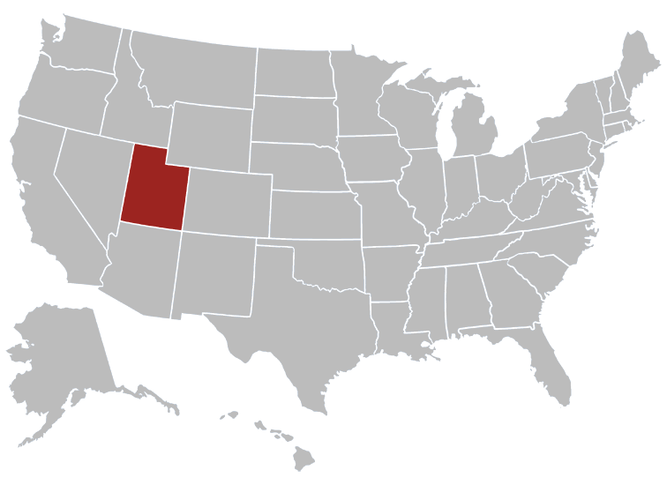
Utah Needs Encircle
Leading cause of death for teens is death by suicide
60% higher than the national average for all age groups
Overrepresentation of LGBTQ+ youth among the suicide victims

Slide 6
Top Volunteer Jobs
Speaking with youth and guests
Special event staffing
Baking & cooking
House chores

Slide 7
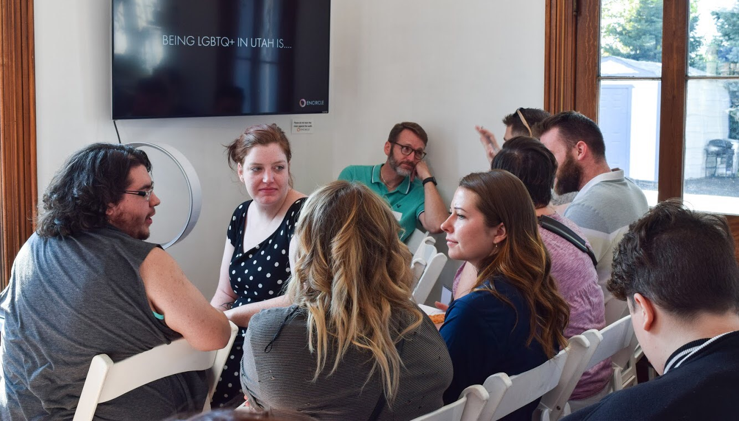
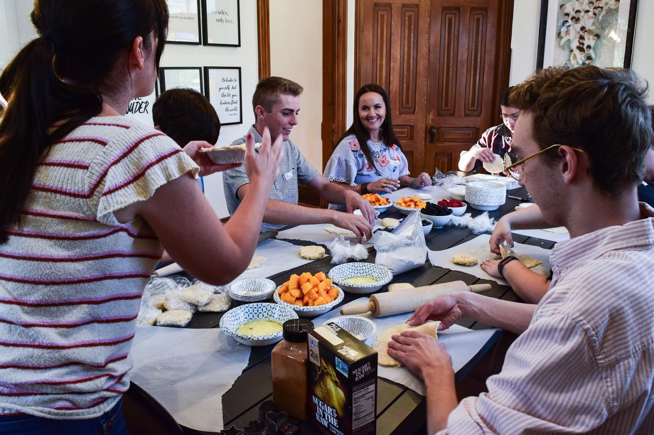
Encircle Volunteer Management Before Salesforce
Volunteer shifts on a shared spreadsheet
No tracking for volunteer training
No security (anyone could change things)
No organization of volunteer paperwork/background checks
No data on program participants

Slide 8


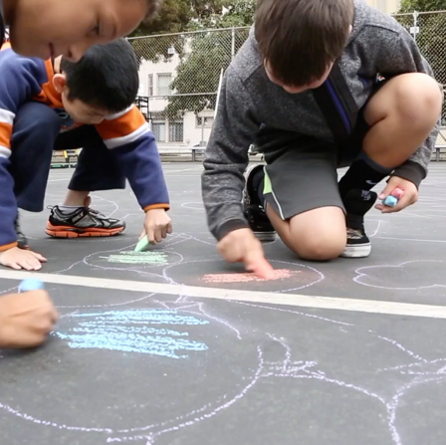


Philanthropy Brings Out the Best in Us
1-1-1 Model
1% Time
1% Equity
1% Product
2.6M⁺
$200M⁺
34 K⁺
Nonprofits & Education
Volunteer hours
Grants

Slide 9
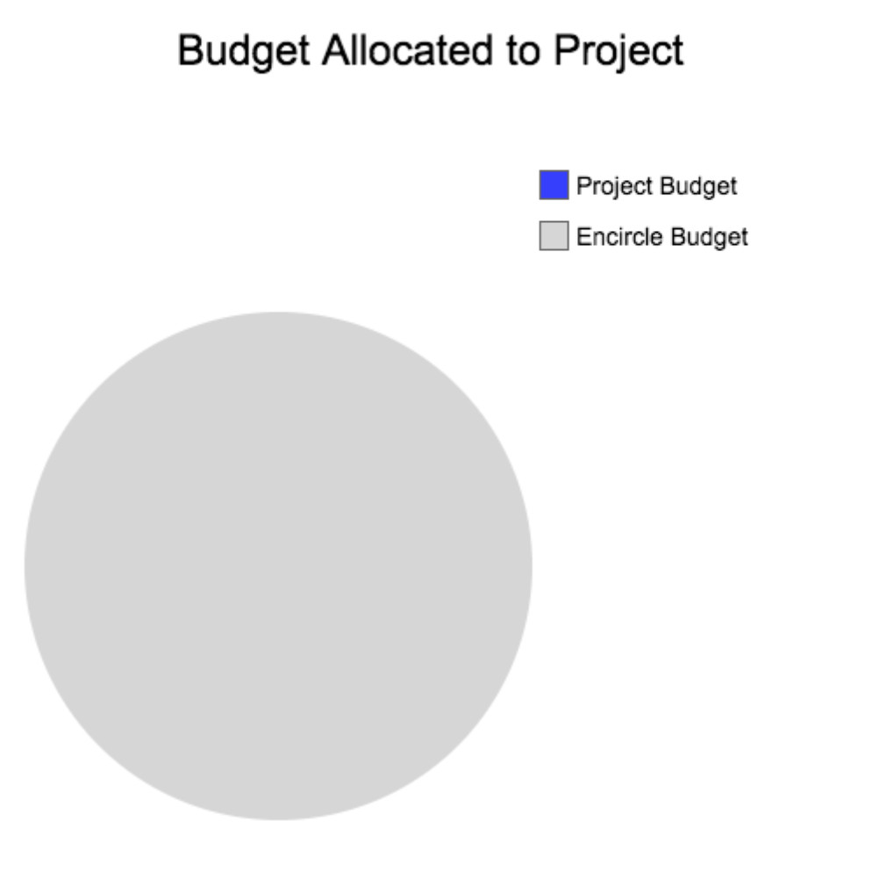
Project Constraints

Slide 10
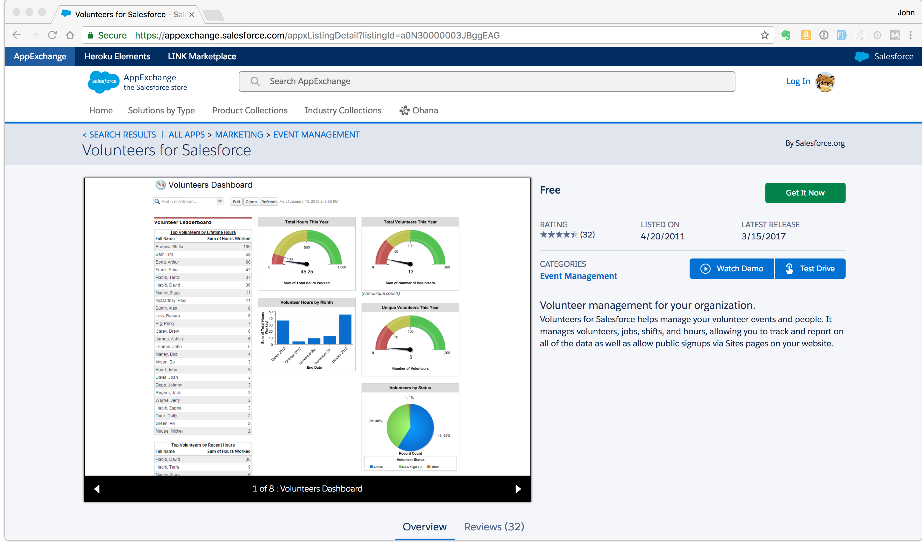
Volunteers for Salesforce
The right price: free
Volunteer shift management
Recurring and one-off volunteer shifts
Volunteer registration
Volunteer shift sign-up
Free on the AppExchange

Slide 11

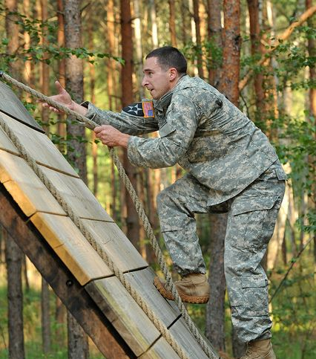
Project Goals
Keep the momentum
Not this:
This:

Slide 12
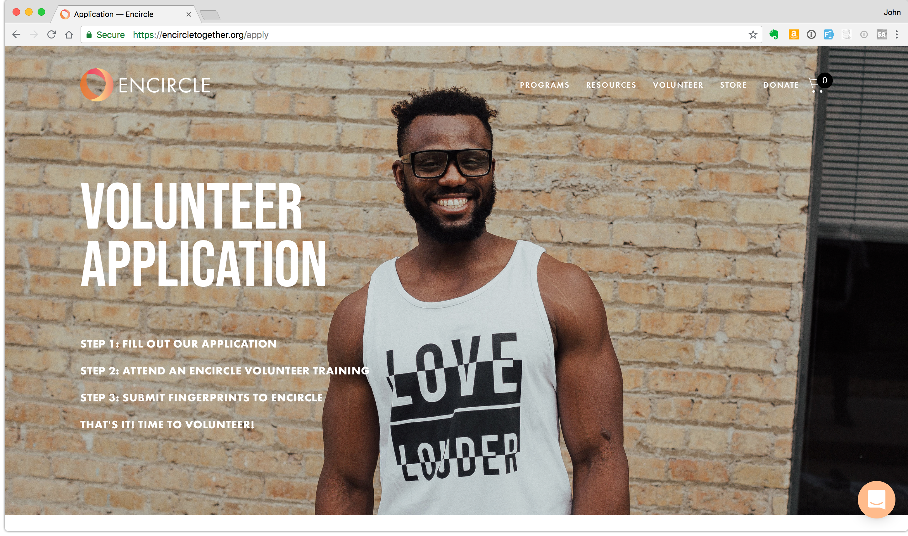

Slide 13
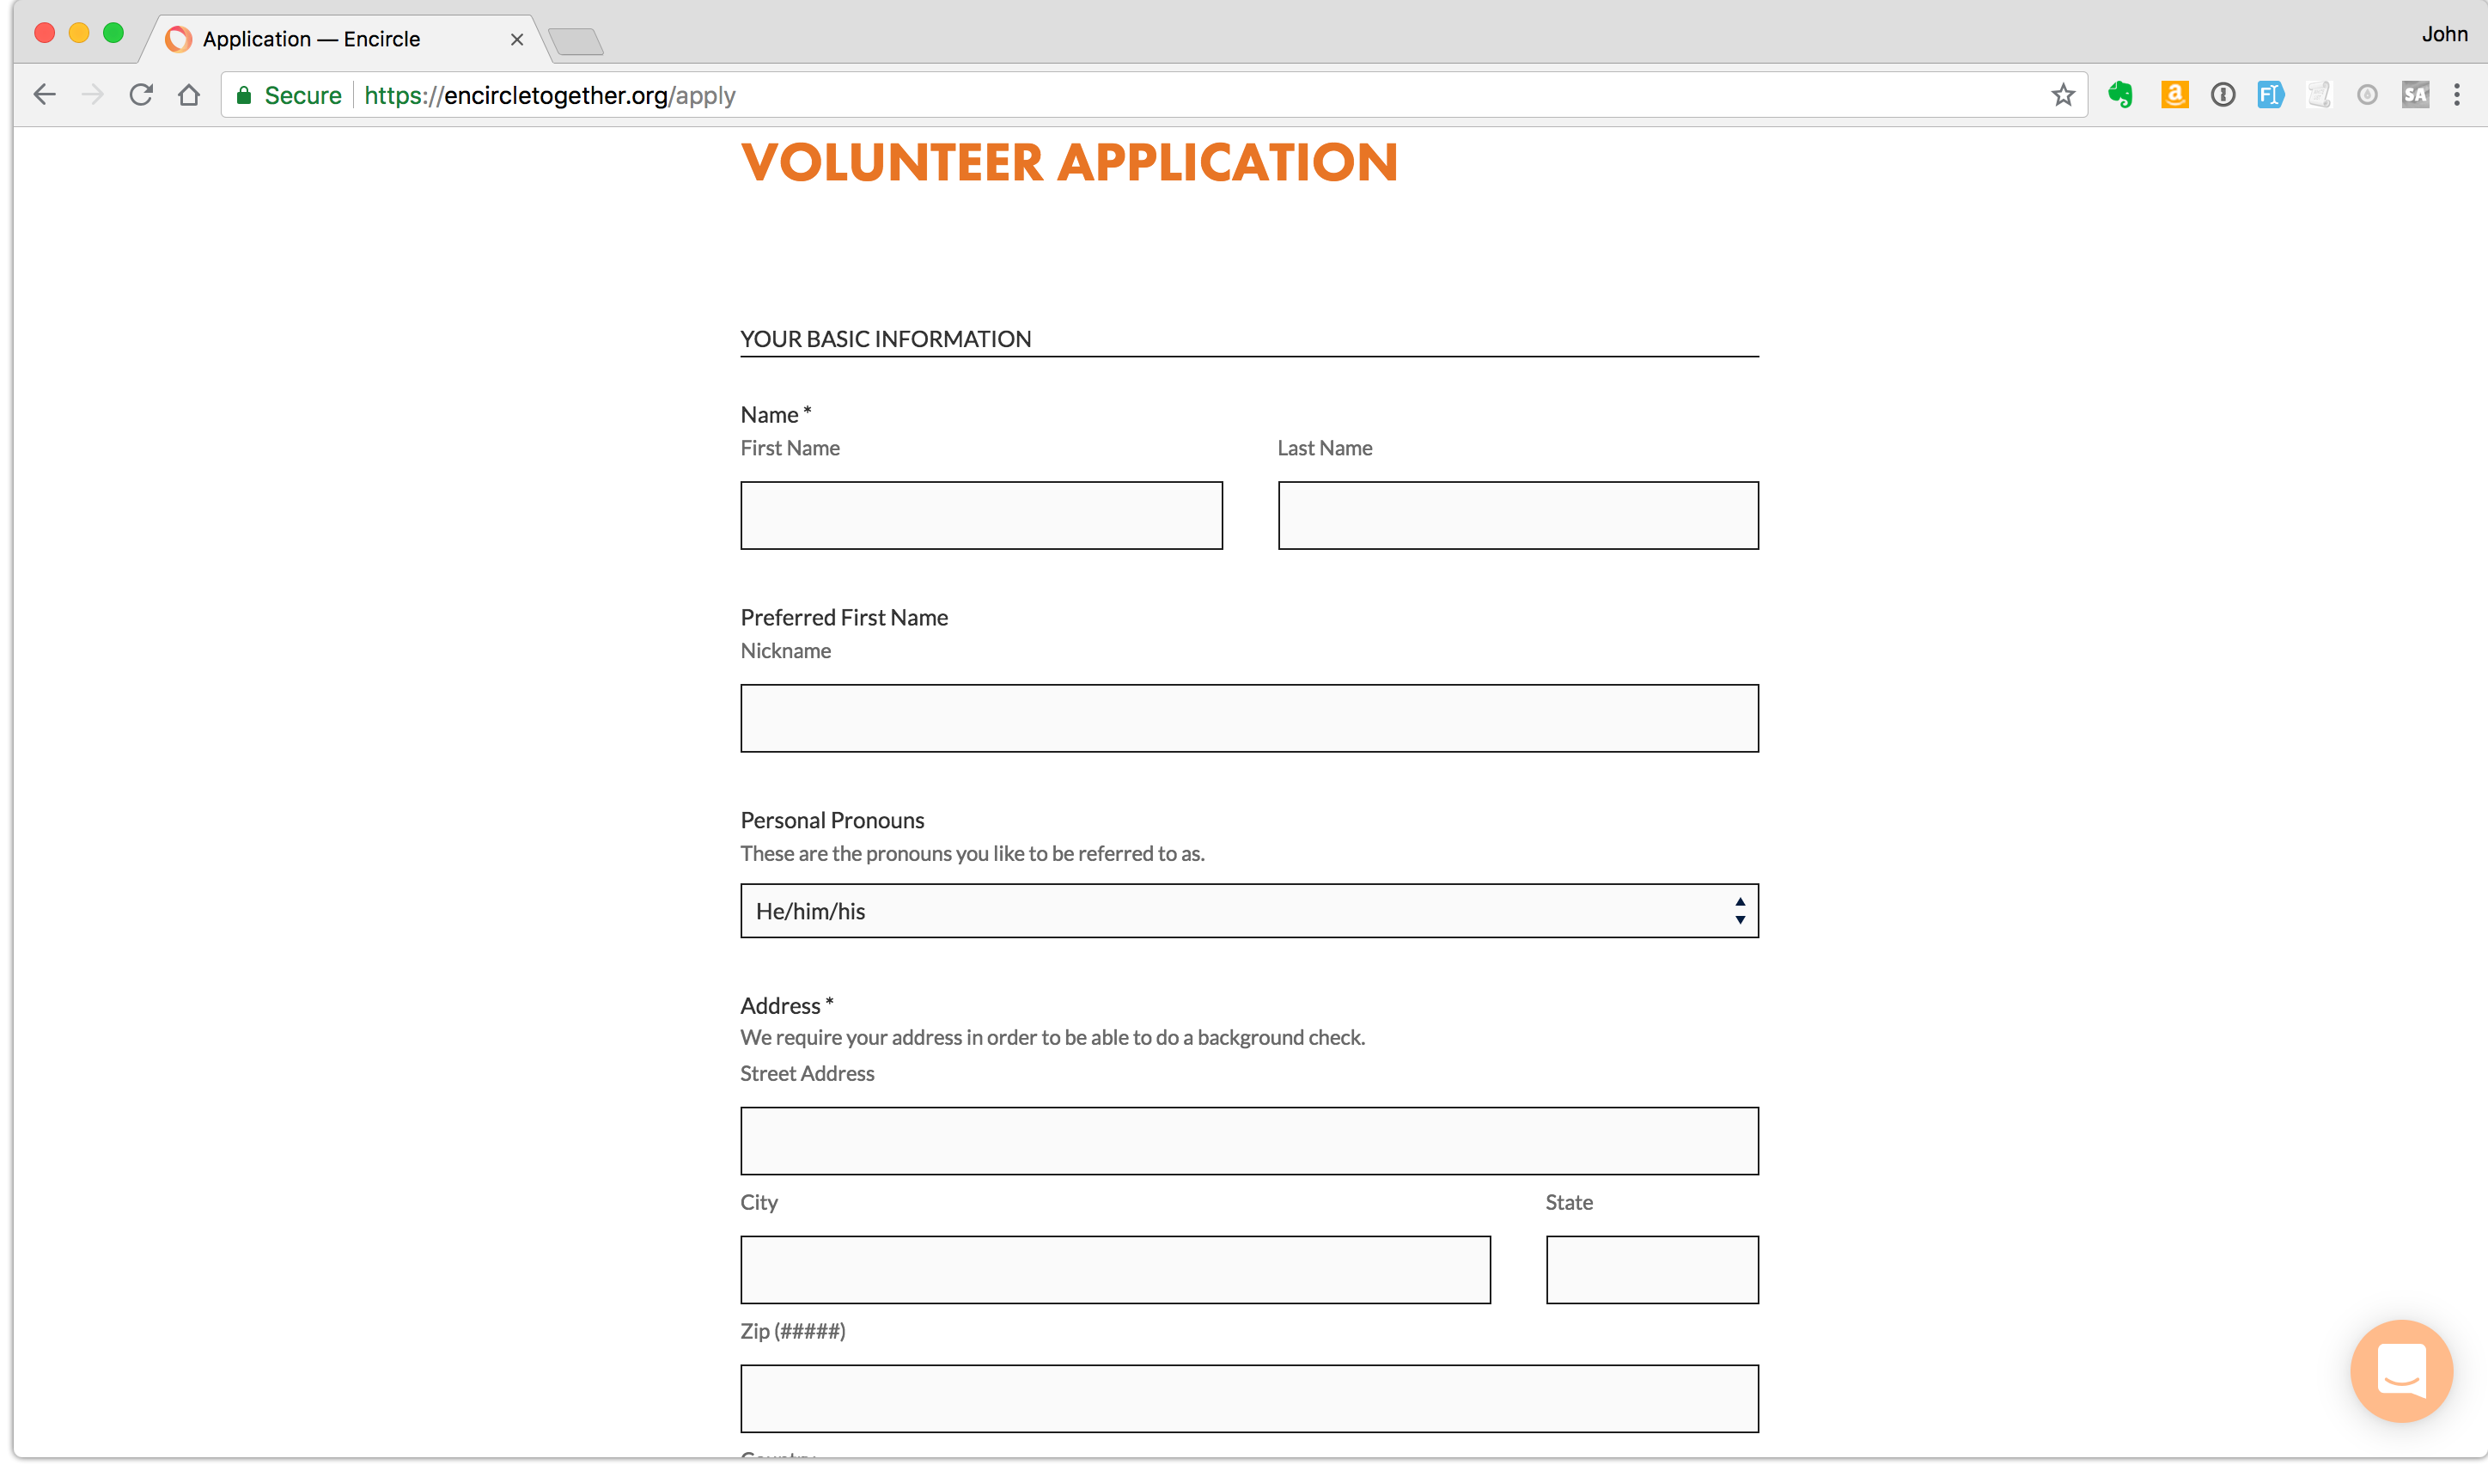

Slide 14
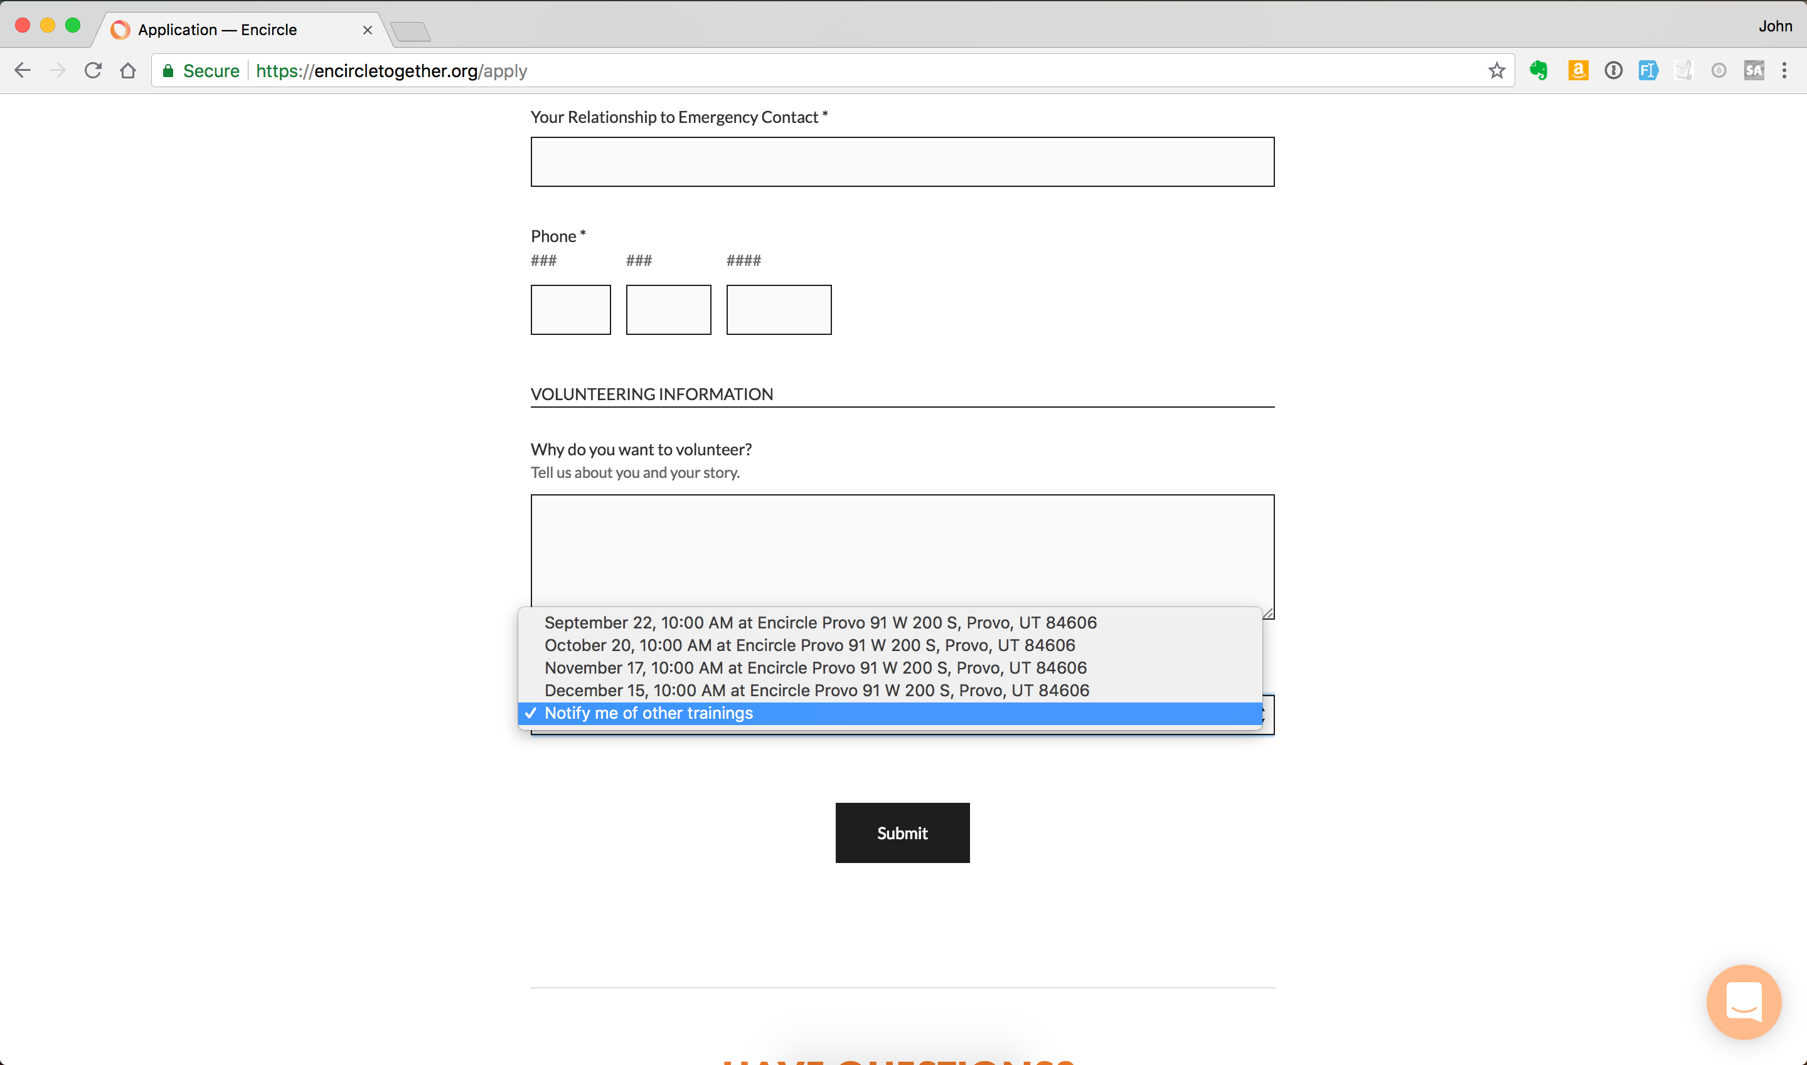

Slide 15
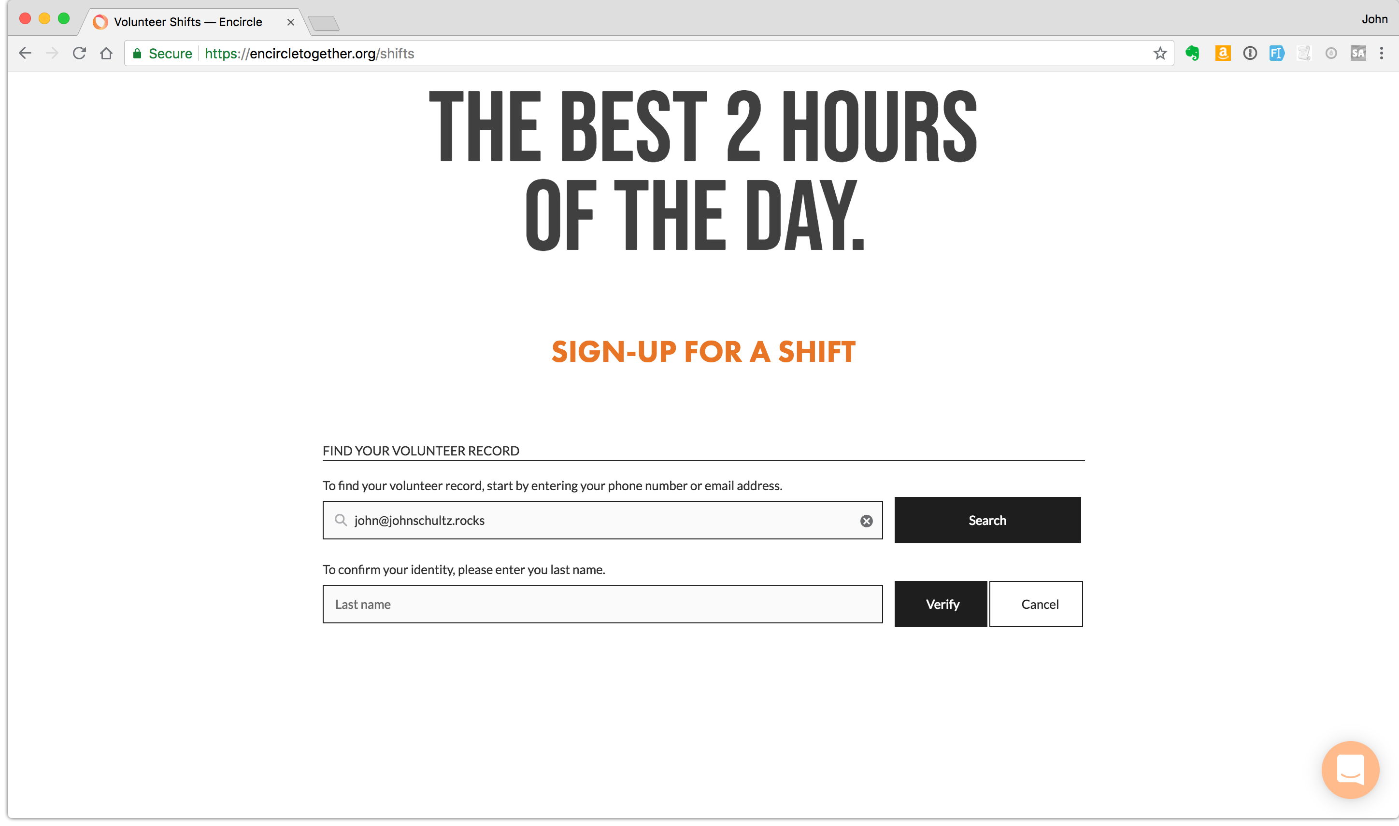

Slide 16
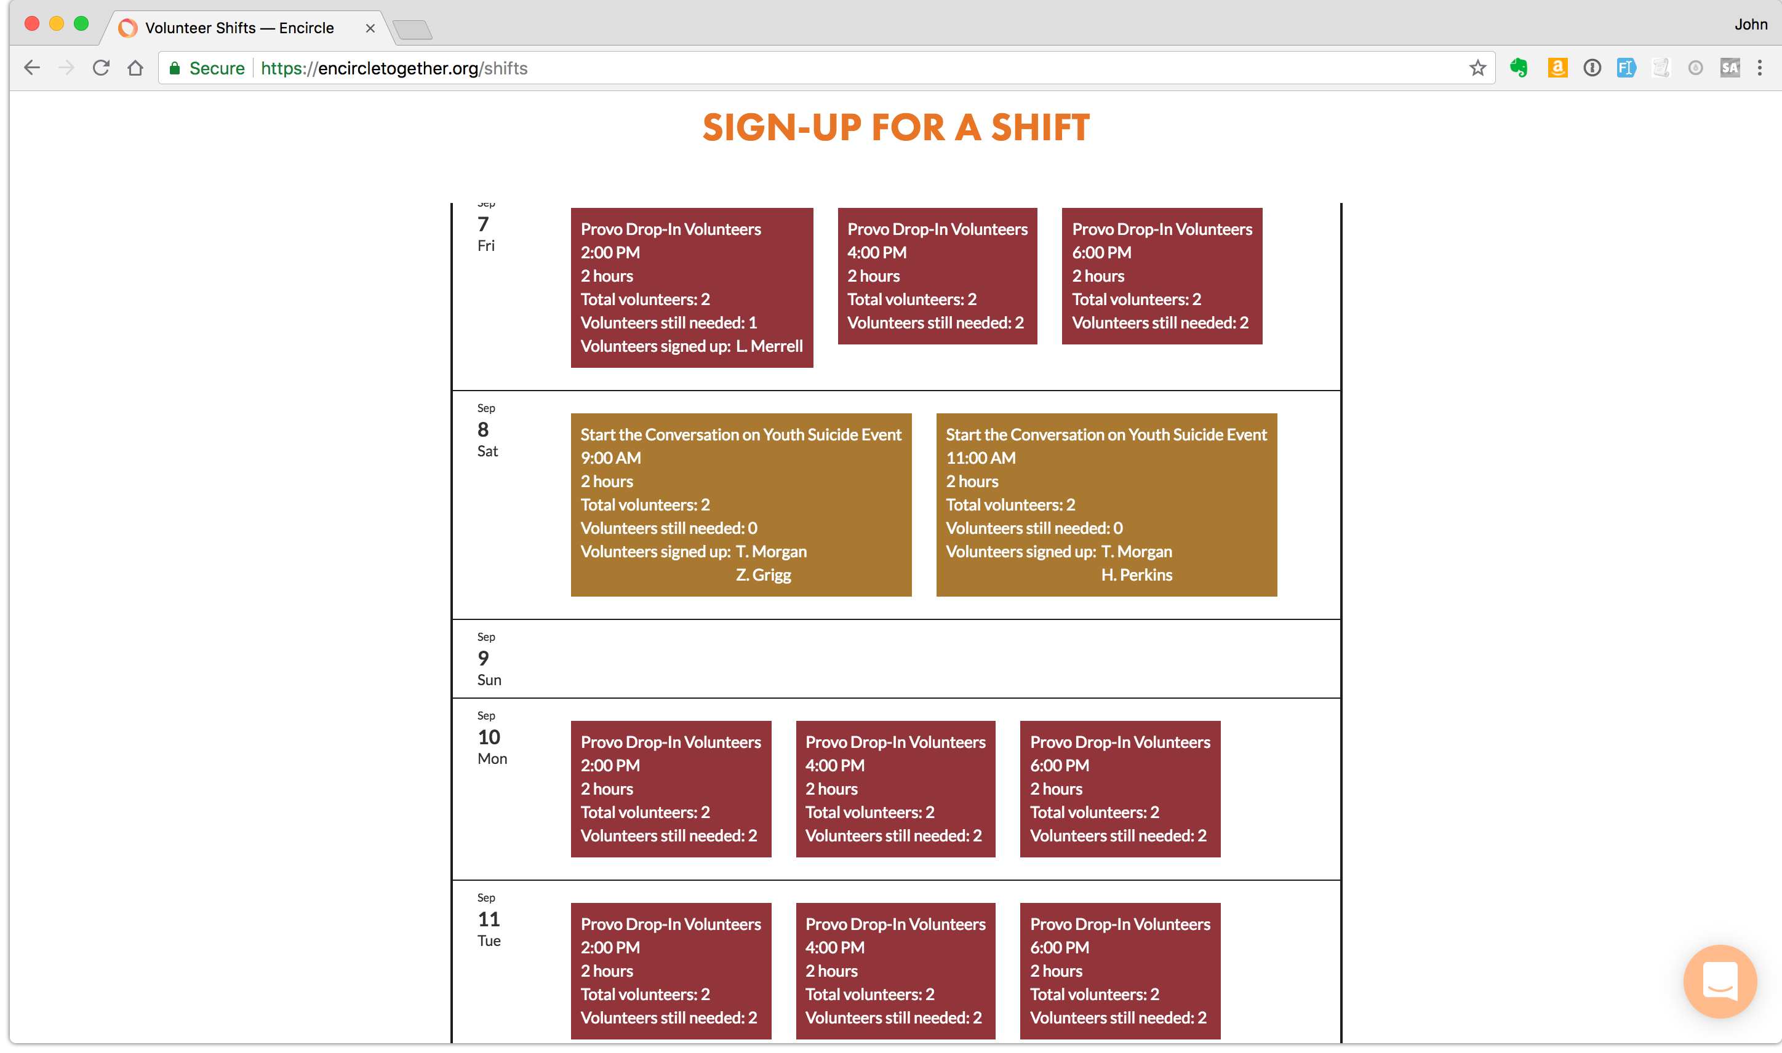

Slide 17

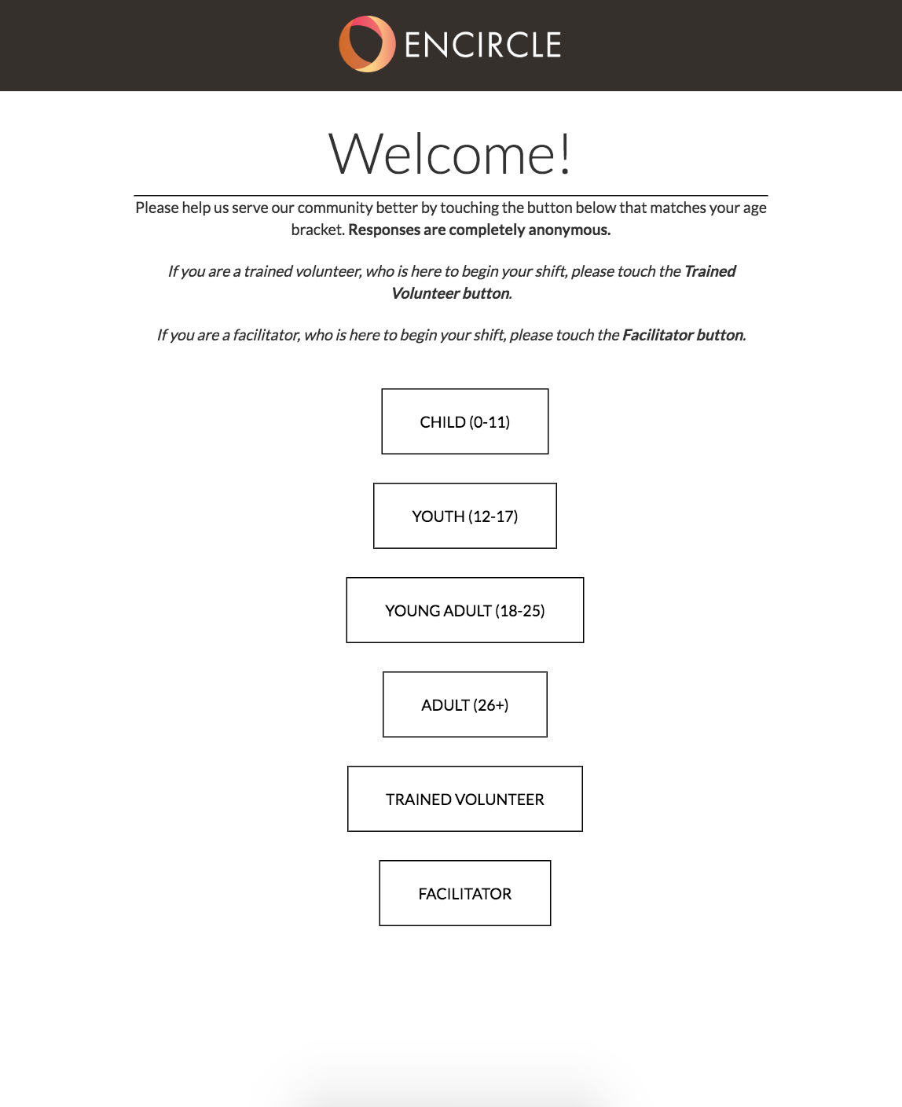

Slide 18
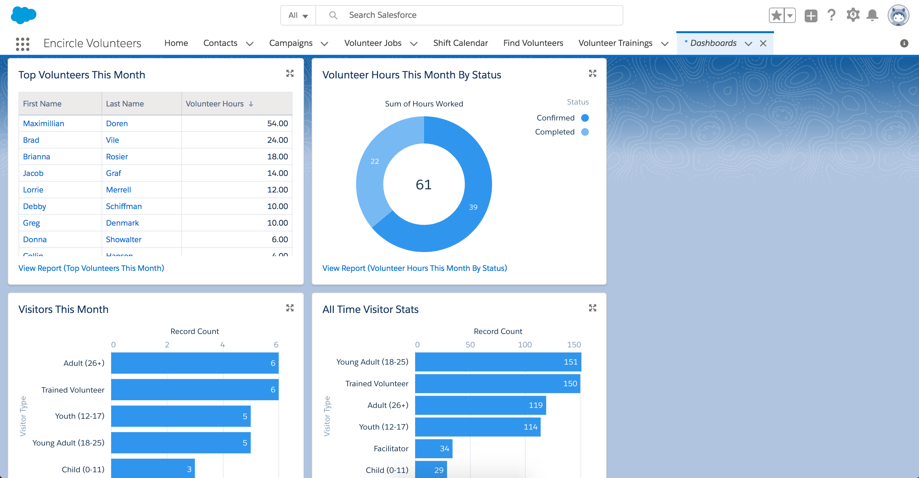
Encircle Volunteer Management With Salesforce
Data for donors and grantors about program participants
Background screening tracking
Volunteer training tracking and renewals
Easy volunteer shift management
Reporting on volunteers (MVPs, school requirements, etc.)

Slide 19

Key Outcomes Tracked in Salesforce
30+ volunteers each week
Trained over 700 volunteers in the last year
40+ attendees at monthly trainings
45-60 individuals visit the Encircle house everyday
20 guests per program everyday
>90% reporting that the program is the best part of their week and a safe place

